Slide 1
Quarter 4
Literature Circle Options

Slide 2
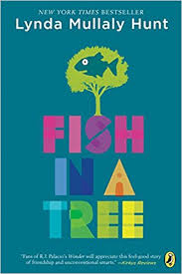
Option 1: Fish in a Tree
by Lynda Mullaly Hunt Book Trailer Link **Watch the trailer!
Ally has been smart enough to fool a lot of smart people. Every time she lands in a new school, she is able to hide her inability to read by creating clever yet disruptive distractions. She is afraid to ask for help; after all, how can you cure dumb? However, her newest teacher Mr. Daniels sees the bright, creative kid underneath the trouble maker. With his help, Ally learns not to be so hard on herself and that dyslexia is nothing to be ashamed of. As her confidence grows, Ally feels free to be herself and the world starts opening up with possibilities. She discovers that there’s a lot more to her—and to everyone—than a label, and that great minds don’t always think alike.

Slide 3
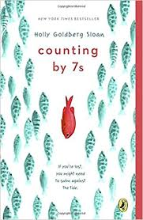
Option 2: Counting by 7’s
By Holly Goldberg Sloan Book Trailer **Watch the trailer!
Willow Chance is a twelve-year-old genius, obsessed with nature and diagnosing medical conditions, who finds it comforting to count by 7s. It has never been easy for her to connect with anyone other than her adoptive parents, but that hasn’t kept her from leading a quietly happy life... until now.
Suddenly Willow’s world is tragically changed when her parents both die in a car crash, leaving her alone in a baffling world. The triumph of this book is that it is not a tragedy. This extraordinarily odd, but extraordinarily endearing, girl manages to push through her grief. Her journey to find a fascinatingly diverse and fully believable surrogate family is a joy and a revelation to read.

Slide 4
Option 3: Stargirl
By Jerry Spinelli Book Trailer **Watch the trailer!
Stargirl. From the day she arrives at quiet Mica High in a burst of color and sound, the hallways hum with the murmur of “Stargirl, Stargirl.” She captures Leo Borlock’ s heart with just one smile. She sparks a school-spirit revolution with just one cheer. The students of Mica High are enchanted. At first.
Then they turn on her. Stargirl is suddenly shunned for everything that makes her different, and Leo, panicked and desperate with love, urges her to become the very thing that can destroy her: normal. In this celebration of nonconformity, Newbery Medalist Jerry Spinelli weaves a tense, emotional tale about the perils of popularity and the thrill and inspiration of first love.

Slide 5
Option 4: Out of my Mind
By Sharon Draper Book Trailer **Watch the trailer!
Melody is not like most people. She cannot walk or talk, but she has a photographic memory; she can remember every detail of everything she has ever experienced. She is smarter than most of the adults who try to diagnose her and smarter than her classmates in her integrated classroom—the very same classmates who dismiss her as mentally challenged, because she cannot tell them otherwise. But Melody refuses to be defined by cerebral palsy. And she’s determined to let everyone know it…somehow.

Slide 6
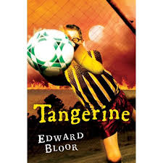
Option 5: Tangerine
By Edward Bloor Book Trailer **Watch the trailer!
Paul Fisher sees the world from behind glasses so thick he looks like a bug-eyed alien. But he’s not so blind that he can’t see there are some very unusual things about his family’s new home in Tangerine County, Florida. Where else does a sinkhole swallow the local school, fire burn underground for years, and lightning strike at the same time every day? The chaos is compounded by constant harassment from his football–star brother, and adjusting to life in Tangerine isn’t easy for Paul—until he joins the soccer team at his middle school. With the help of his new teammates, Paul begins to discover what lies beneath the surface of his strange new hometown. And he also gains the courage to face up to some secrets his family has been keeping from him for far too long. In Tangerine, it seems, anything is possible.

Slide 7
Option 6: Drums, Girls, and Dangerous Pie
By Jordan Sonnenblick Book Trailer **Watch the trailer!
Steven plays drums in the All-City Jazz Band (whose members call him the Peasant), has a crush on the hottest girl in school (who doesn't even know he's alive), and is constantly annoyed by his younger brother, Jeffrey (who is cuter than cute - which is also pretty annoying). But when Jeffrey gets sick, Steven's world is turned upside down, and he is forced to deal with his brother's illness, his parents' attempts to keep the family in one piece, his homework, the band, girls, and Dangerous Pie (yes, you'll have to read the book to find out what that is!).

Slide 8
Option 7: The Skin I’m in
By Sharon G. Flake Book Trailer **Watch the trailer!
Miss Saunders, whose skin is blotched with a rare skin condition, serves as a mirror to Maleeka Madison's struggle against the burden of low self-esteem that many black girls face when they're darker skinned. Miss Saunders is tough and through this, Maleeka learns to stand up to tough-talking Charlese.

